Slide 1

Customer Segmentation
By Team Orange

Slide 2
Executive Summary
Percentage of opt-ins is an issue among registered users
Different groups require different approaches in order to increase overall engagement.
Recommendation: Alternate marketing campaigns to drive email signups. A/B tests on the platform amongst small samples to determine effective marketing options
Recommendation: Targeted marketing campaigns to increase brand engagement. A/B tests to find the most effective format

Slide 3
Definitions
Champion – Customers who have purchased within the last 6 months, frequently and spend more
Loyal - Customers who buy frequently but don’t fit into the Champion Group
Whale – Large spenders
New – Customers who have placed orders recently with any frequency and low to medium purchase value
At Risk - Customers who have purchased more than 9 months ago
Lost - Customers who have not purchased in over 12 months

Slide 4
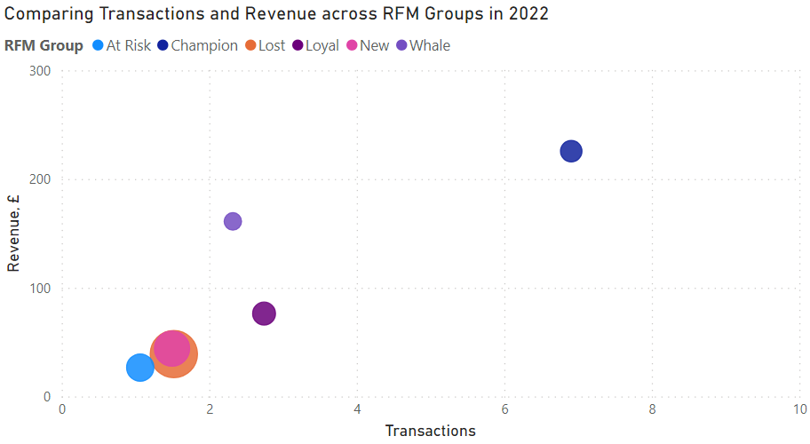
Different groups require different approaches in order to increase overall engagement.

Slide 5
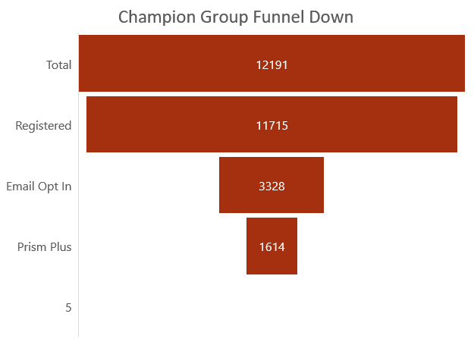
Champions
Insight: Average transaction count for Prism+ is higher than users without loyalty.
Recommendation: Send thank you emails, exclusive offers and introduce new users to Prism+
Impact: Solidify high-revenue customer loyalty

Slide 6
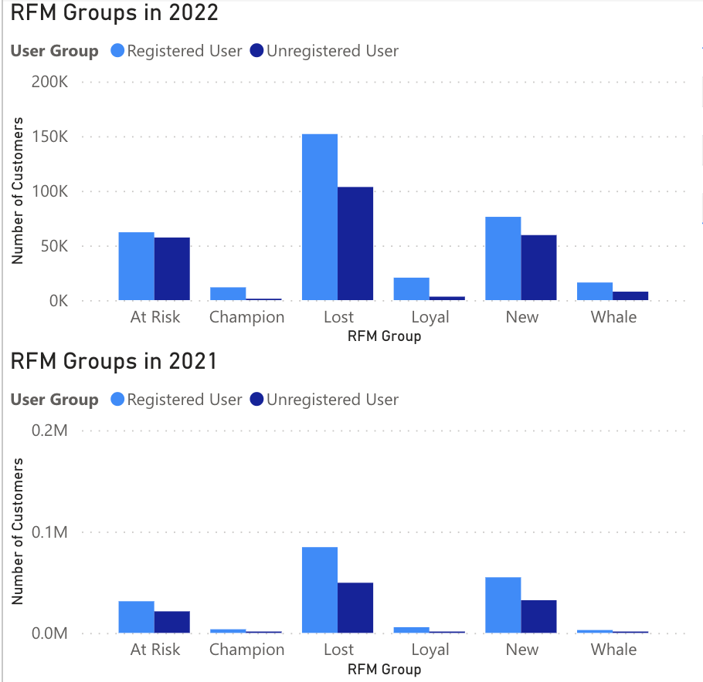
Lost Group
Insight: We are losing more customers YoY
Recommendation: Plan re-engagement email offering a substantial discount. A/B test.
Impact: Bring back 15% of Lost users

Slide 7
New Customers
Insight: Around 9000 new customers opt in.
Recommendation: Use Prism+ to partner with Everyman Cinemas and Alton Towers
Impact: Converting new users to loyal group by encouraging increased frequency

Slide 8
Contacting is an issue among registered users
Insight: On average, less than 15% of users are contactable.
Impact: Getting 10% of uncontactable only at-risk users to opt-in for communication could enable re-engagement efforts with over 6,000 users.
Recommendation: Offer discounts on next orders when you opt in to emails.

Slide 9
Executive Summary
Percentage contactable is an issue
Different groups have different spending trends
Recommendation: Alternate marketing campaigns to drive email signups. A/B tests on the platform amongst small samples to determine effective marketing options.
Recommendation: Targeted marketing campaigns to increase brand engagement. A/B tests to find the most effective format

Slide 10
Appendix 1: RFM Ranks
Recency Rank | Date | Frequency Rank | Transactions | Monetary Rank | Amount
1 | More Than a Year | 1 | 1 | 1 | <10
2 | Q1 | 2 | 2 | 2 | >=10
3 | Q2 | 3 | 3 | 3 | >=31.62
4 | Within last 6 months | 4 | 4 | 4 | >=100

Slide 11
Appendix 2: RFM Score Groups
Champions | Loyal | Whales | New | At Risk | Lost
444, 443, 344 | 341, 342, 343, 441, 442, 434, 333, 332, 242, 323, 233, 232, 243 | 214, 224, 234, 244, 314, 324, 334, 414, 424 | 411, 421, 431, 412, 422, 432, 413, 423, 433 | 211, 212, 213, 221, 313, 311, 321, 312, 322, 222, 223 | 111, 121, 131, 141, 112, 122, 132, 142, 113, 123, 133, 143, 114, 124, 134, 144

Slide 12
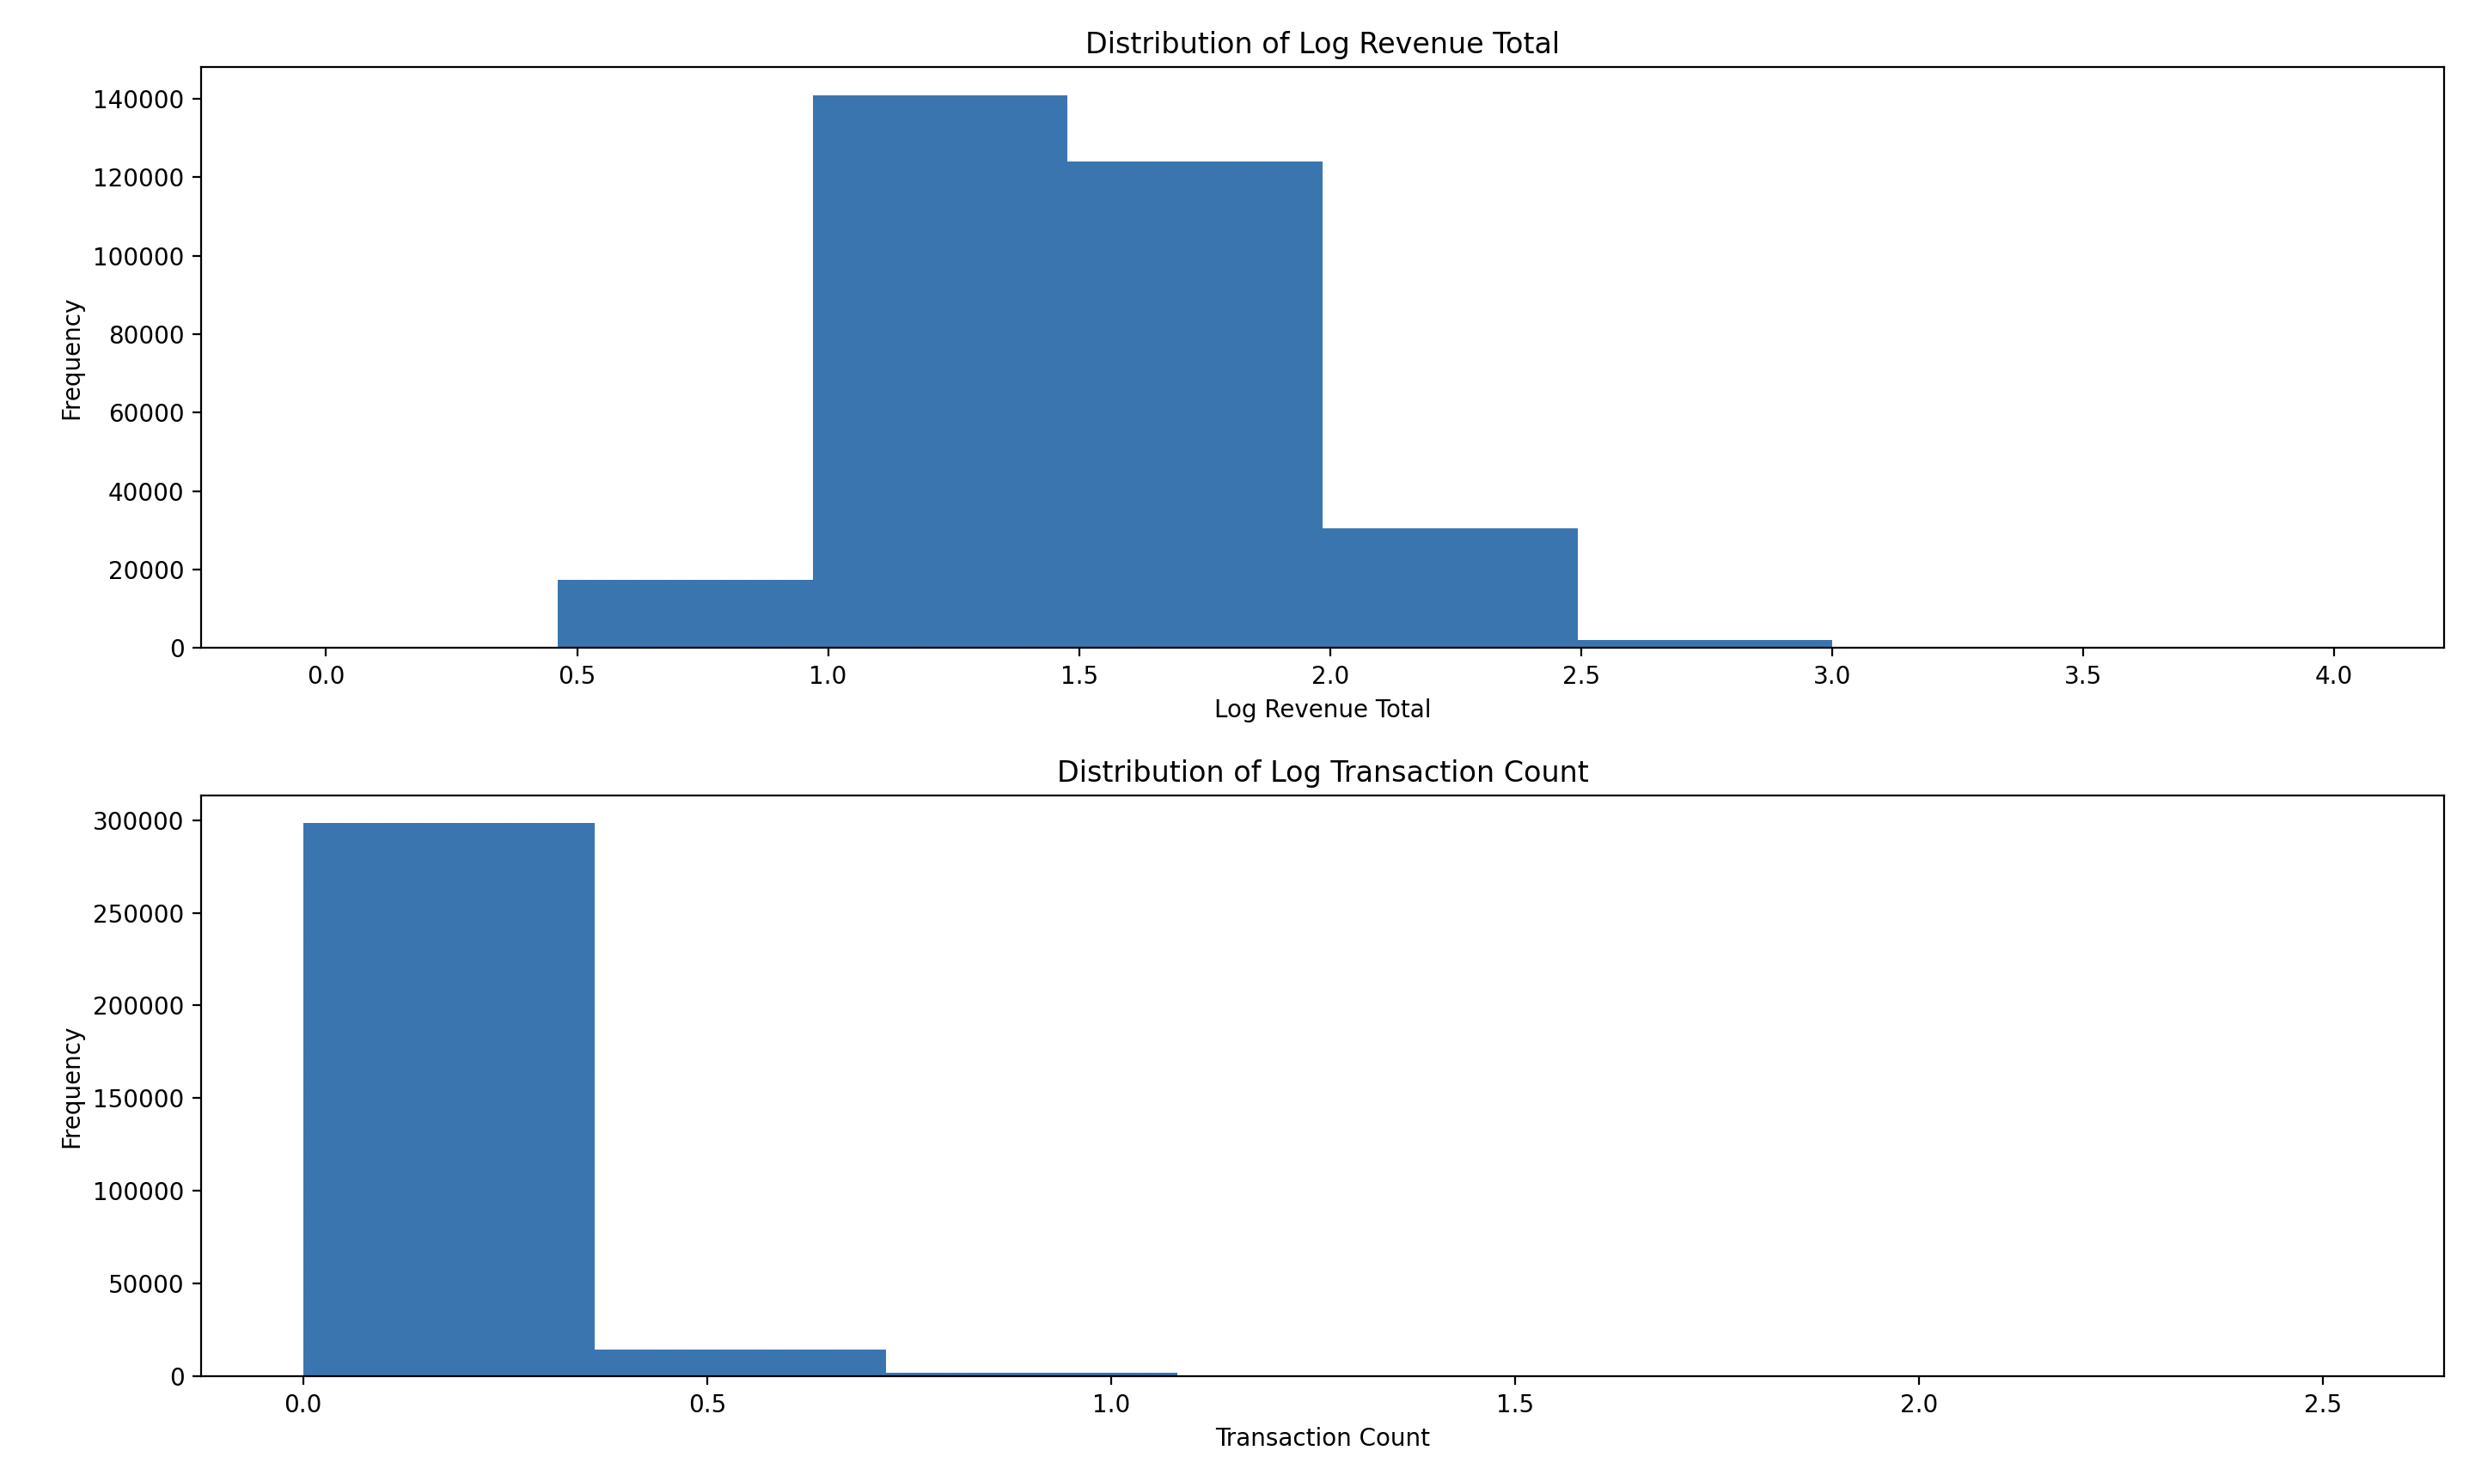
Appendix 3: Histograms

Slide 13
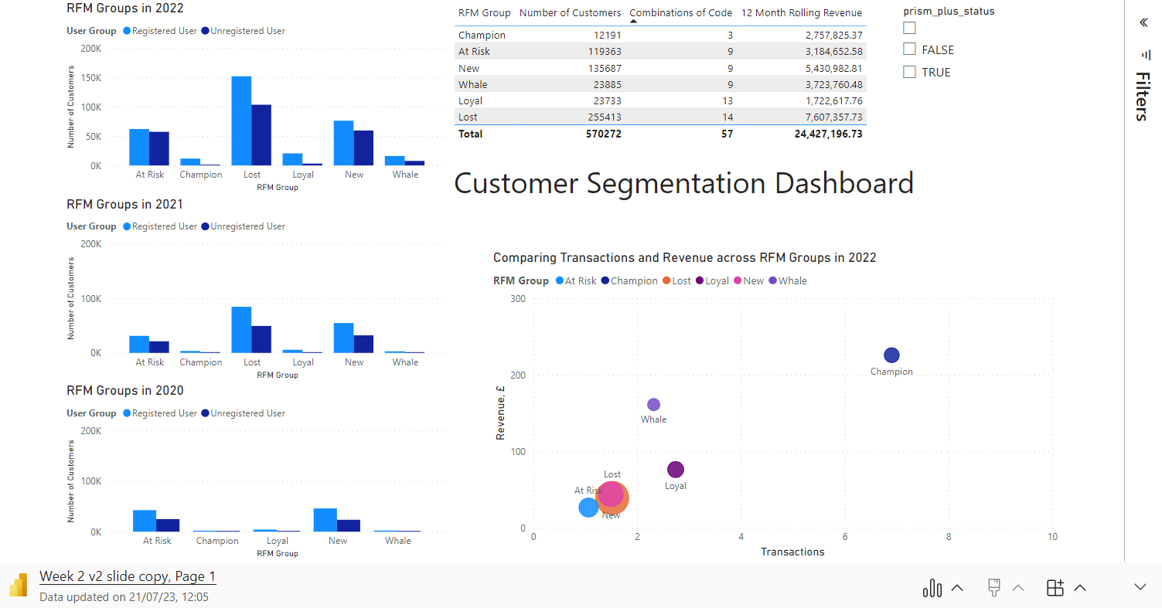
Appendix 4: Dashboard

